Slide 1
Epidemics on Networks
Notes:
Summary from VC2: results from trial survey; cholera; spatial spread model

Slide 2
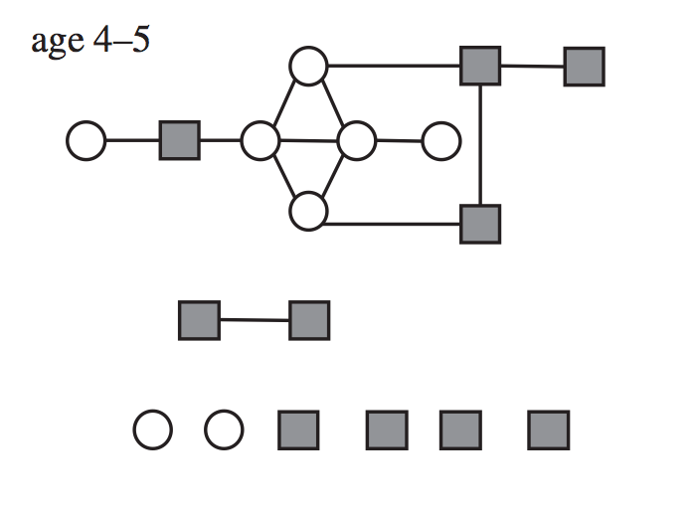
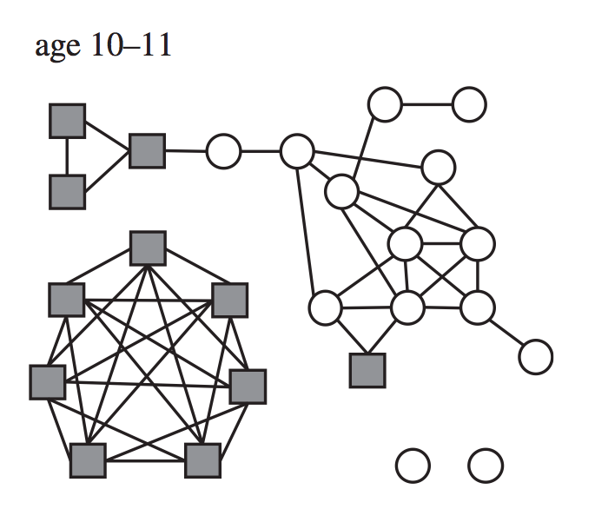
Social networks
Age 4–5
Age 10–11

Slide 3
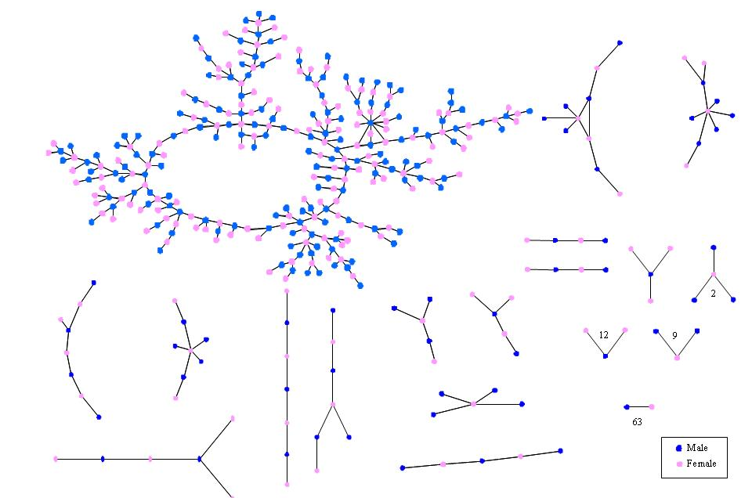
Romantic network in US high school

Slide 4
How does an epidemic spread on a network?
Notes:
c.f. “The Network Disease” from VC1.

Slide 5
How does an epidemic spread on a network?
Day 1
Everyone starts off susceptible, apart from one infected person
Notes:
c.f. “The Network Disease” from VC1.

Slide 6
How does an epidemic spread on a network?
Day 2
• Go round infected person’s contacts in turn
Notes:
c.f. “The Network Disease” from VC1.

Slide 7
How does an epidemic spread on a network?
Day 2
• Go round infected person’s contacts in turn
• Roll dice. If number is 1 or 2, infect that person
Notes:
c.f. “The Network Disease” from VC1.

Slide 8
How does an epidemic spread on a network?
Day 2
• Go round infected person’s contacts in turn
• Roll dice. If number is 1 or 2, infect that person
Notes:
c.f. “The Network Disease” from VC1.

Slide 9
How does an epidemic spread on a network?
Day 2
• Go round infected person’s contacts in turn
• Roll dice. If number is 1 or 2, infect that person
• Continue for all contacts
Notes:
c.f. “The Network Disease” from VC1.

Slide 10
How does an epidemic spread on a network?
Day 2
• Go round infected person’s contacts in turn
• Roll dice. If number is 1 or 2, infect that person
• Continue for all contacts
Notes:
c.f. “The Network Disease” from VC1.

Slide 11
How does an epidemic spread on a network?
Day 2
• Go round infected person’s contacts in turn
• Roll dice. If number is 1 or 2, infect that person
• Continue for all contacts
Notes:
c.f. “The Network Disease” from VC1.

Slide 12
How does an epidemic spread on a network?
Day 2
• Go round infected person’s contacts in turn
• Roll dice. If number is 1 or 2, infect that person
• Continue for all contacts
Notes:
c.f. “The Network Disease” from VC1.

Slide 13
How does an epidemic spread on a network?
Day 2
• Go round infected person’s contacts in turn
• Roll dice. If number is 1 or 2, infect that person
• Continue for all contacts
Notes:
c.f. “The Network Disease” from VC1.

Slide 14
How does an epidemic spread on a network?
Day 2
• Go round infected person’s contacts in turn
• Roll dice. If number is 1 or 2, infect that person
• Continue for all contacts, then infected person recovers
Notes:
c.f. “The Network Disease” from VC1.

Slide 15
How does an epidemic spread on a network?
Day 2
• Go round infected person’s contacts in turn
• Roll dice. If number is 1 or 2, infect that person
• Continue for all contacts, then infected person recovers
Notes:
c.f. “The Network Disease” from VC1.

Slide 16
How does an epidemic spread on a network?
Day 3
• Start with two infected people
• For each infected person, roll dice for each contact
Notes:
c.f. “The Network Disease” from VC1.

Slide 17
How does an epidemic spread on a network?
Day 3
• Start with two infected people
• For each infected person, roll dice for each contact
Notes:
c.f. “The Network Disease” from VC1.

Slide 18
How does an epidemic spread on a network?
Day 3
• Start with two infected people
• For each infected person, roll dice for each contact
Notes:
c.f. “The Network Disease” from VC1.

Slide 19
How does an epidemic spread on a network?
Day 3
• Start with two infected people
• For each infected person, roll dice for each contact
Notes:
c.f. “The Network Disease” from VC1.

Slide 20
How does an epidemic spread on a network?
Day 3
• Start with two infected people
• For each infected person, roll dice for each contact
Notes:
c.f. “The Network Disease” from VC1.

Slide 21
How does an epidemic spread on a network?
Day 3
• Start with two infected people
• For each infected person, roll dice for each contact
Notes:
c.f. “The Network Disease” from VC1.

Slide 22
How does an epidemic spread on a network?
Day 3
• Start with two infected people
• For each infected person, roll dice for each contact
Notes:
c.f. “The Network Disease” from VC1.

Slide 23
How does an epidemic spread on a network?
Day 3
• Start with two infected people
• For each infected person, roll dice for each contact
Notes:
c.f. “The Network Disease” from VC1.

Slide 24
How does an epidemic spread on a network?
Day 3
• Start with two infected people
• For each infected person, roll dice for each contact
Notes:
c.f. “The Network Disease” from VC1.

Slide 25
How does an epidemic spread on a network?
Day 3
• Start with two infected people
• For each infected person, roll dice for each contact
Notes:
c.f. “The Network Disease” from VC1.

Slide 26
How does an epidemic spread on a network?
Day 3
• Start with two infected people
• For each infected person, roll dice for each contact
Notes:
c.f. “The Network Disease” from VC1.

Slide 27
How does an epidemic spread on a network?
Day 3
• Start with two infected people
• For each infected person, roll dice for each contact
Notes:
c.f. “The Network Disease” from VC1.

Slide 28
How does an epidemic spread on a network?
Day 4
• Start with two infected people
• Continue until epidemic ends
Notes:
c.f. “The Network Disease” from VC1.

