Slide 1
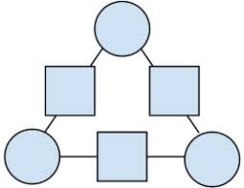
19
27
4
1. This is an Arithmagon…

Slide 2
19
27
4
2. Look at the 2 “top” squares…

Slide 3
27 is 8 bigger
19
27
4
3. See which one is bigger, and by how much.

Slide 4
19
27
a
4
4. If the bottom-left circle is a…

Slide 5
19
27
a
4
a + 8
5. …then the bottom-right corner is a + 8.

Slide 6
19
27
a
4
a + 8
2a + 8
6. This means 4 equals 2a + 8.

Slide 7
19
27
a
-4
a + 8
2a
7. Take away 8… and we find out -4 is 2a.

Slide 8
19
27
a
-2
a + 8
a
8. This means a must equal -2.

Slide 9
19
27
-2
4
6
9. Knowing what a equals, we can fill in the 2 bottom circles…

Slide 10
21
19
27
-2
4
6
10. Which just leaves the top circle to fill in… and the Arithmagon is solved!

