Slide 1
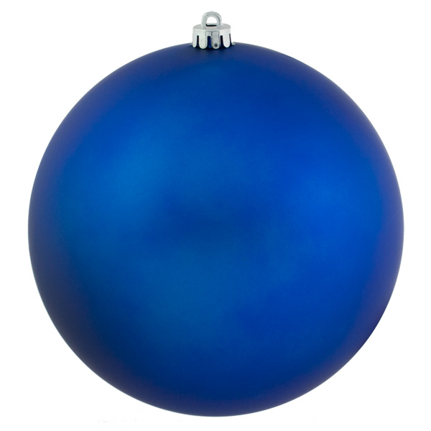
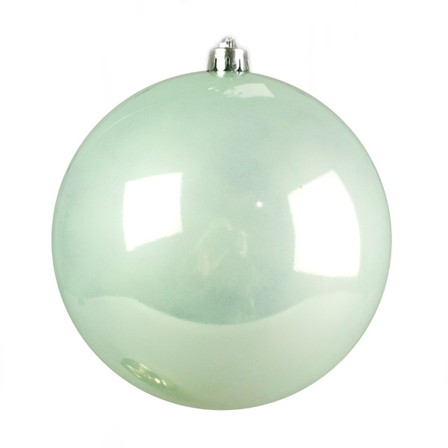
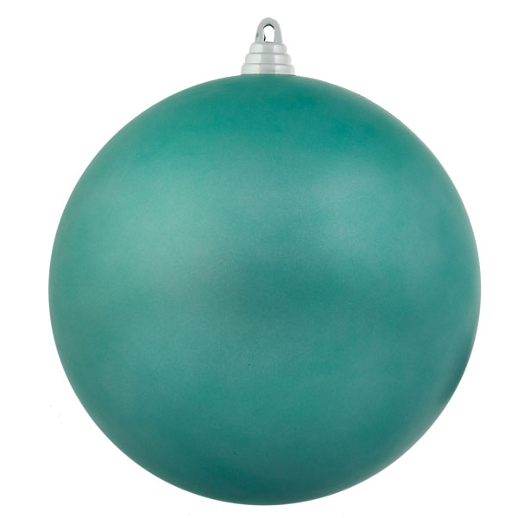
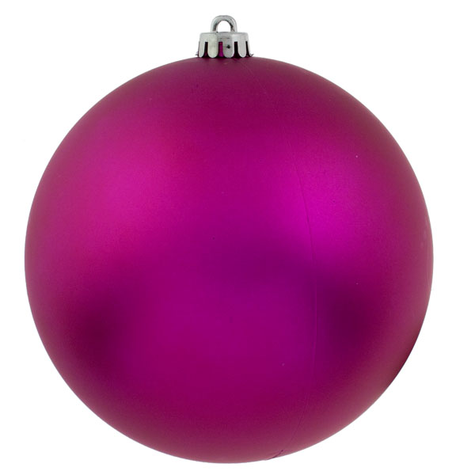
Christmas ‘Magic Trees’
Can you place the numbers 1-5 on the four Christmas baubles and the star in such a way that the two sides of the tree add up to the same total….
You could record the total on the pot of the tree
Can you find another way to do it?
Do you notice anything about the numbers you can put in the star at the top?
Can you explain why some numbers work in the star and some don’t?

